Slide 1

Basics of Data Analysis, Visualization & Machine Learning

Slide 2

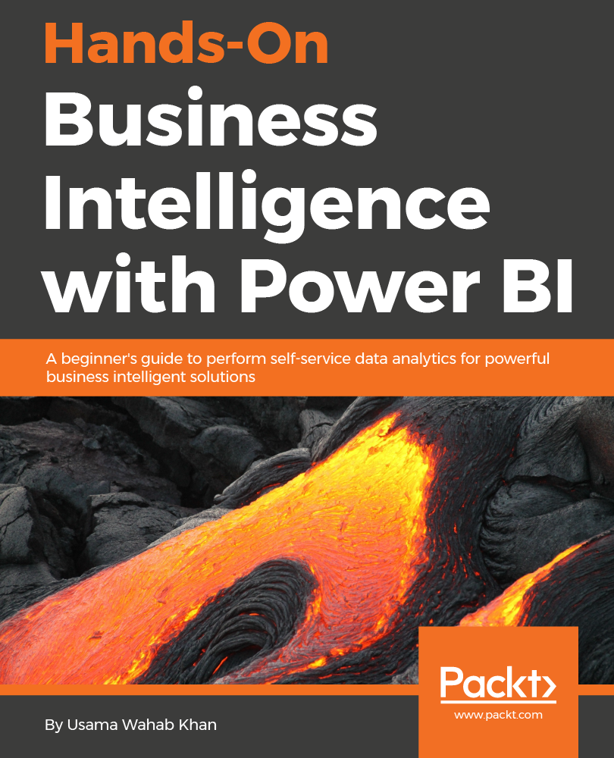













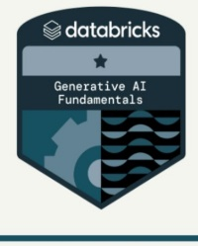


Usama Wahab Khan
Father, data Scientist, Developer/Nerd, Traveler
Twitter : @usamawahabkhan
LinkedIn : Usamawahabkhan

Slide 3


Today’s Opportunity – Your Opportunity

Slide 4

Topic
Foundations of Data Analysis and Visualization
What is Data Analysis? | Module # 1
Data Types & Sources
Hands-On Exercise: Load and explore a dataset using Pandas in Python. Dataset example: Sales or e-commerce data.
Data Preprocessing | Module # 2
Exploring Steps in Preprocessing
Hands-On Exercise: Use Python to clean and preprocess a dataset.
Exploratory Data Analysis (EDA) in depth | Module # 3
Advanced Data Visualization
Foundations of Machine Learning | Module # 4
Supervised and unsupervised Learning Basics | Module # 5
Best Practices & Ethical Considerations | Module # 6
Q&A | Module # 7

Slide 5
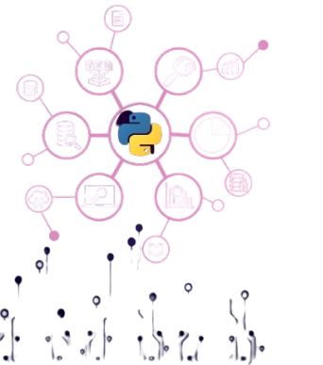
Introduction to Data Analysis & Interpretation with Python

Slide 6
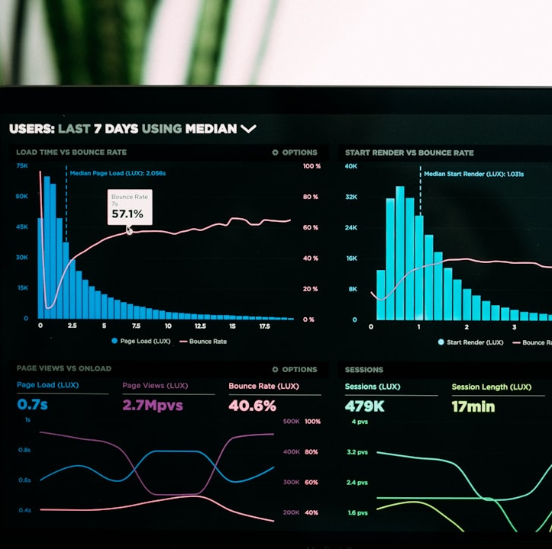
Overview of data analysis
Data analysis involves inspecting, cleansing, and modelling data to discover useful information, inform conclusions, and support decision-making. Its purpose is to enhance understanding and improve processes.

Slide 7

TYPES OF DATA ANALYSIS
DESCRIPTIVE ANALYSIS
Summarizes past data to identify trends and patterns.
DIAGNOSTIC ANALYSIS
Determines causes of past outcomes through analysis.
PREDICTIVE ANALYSIS
Forecasts future trends based on historical data.

Slide 8
Importance of data analysis in modern software development

Slide 9
Importance of data analysis in modern software development
Data analysis has become absolutely critical and deeply intertwined with modern software development. It's no longer a separate, post-development activity but an integral part of the entire software lifecycle.
Here's a breakdown of its importance:
Understanding User Behavior and Improving User Experience (UX)
Identifying and Resolving Bugs and Performance Issues
Data-Driven Decision Making in Development
Building Intelligent and Adaptive Software
Understanding Business Value and ROI

Slide 10
Data Types
In data analysis, data is often categorized into three main types based on its structure and the level of organization:
Structured Data
Semi-structured Data
Unstructured Data

Slide 11
Structured Data
Structured data is highly organized data that conforms to a predefined data model (schema).
This makes it easy to store, manage, access, and analyze. It typically resides in relational databases and
spreadsheets, with clear rows and columns defining attributes and records.
Characteristics:
Predefined Schema: Has a fixed format and structure known before the data is stored.
Organized: Arranged in tables with rows (representing records or instances) and columns (representing
attributes or features).
Easily Searchable: Can be efficiently queried and manipulated using structured query languages (like SQL).
Quantitative & Qualitative: Can include both numerical (e.g., sales figures) and categorical (e.g., customer
names, product categories) information, as long as they fit the defined structure.
Lower Flexibility: Changes to the data model can be complex and require modifications across the
entire dataset.
Examples:
Relational databases (SQL databases)
Spreadsheets (e.g., Excel, Google Sheets)
CSV (Comma Separated Values) files
Tabular data
Data from point-of-sale systems
Web form results
Sensor data with consistent formats

Slide 12
Semi-structured Data
Semi-structured data doesn't conform to a rigid, predefined schema like structured data, but it does have some organizational properties that make it easier to analyze than unstructured data. It contains tags or markers to separate semantic elements and enforce hierarchies within the data.
Characteristics:
Self-Describing to Some Extent: Contains tags or other markers that provide context about the data.
No Fixed Schema: The structure is not as strict as in relational databases, and attributes can vary between entries.
Flexibility: Easier to change and evolve compared to structured data.
Can be Hierarchical: Often organized in nested structures.
Requires Parsing: Needs to be parsed to extract information for analysis, but the tags provide guidance for this process.
Examples:
JSON (JavaScript Object Notation): Uses key-value pairs and nested objects.
XML (Extensible Markup Language): Uses tags to define elements and attributes.
HTML (Hypertext Markup Language): Tags define the structure of web pages.CSV files with metadata:
For example, a header row describing the columns.Log files: Contain timestamps and event information, often with some consistent formatting but varying messages.

Slide 13
Unstructured Data
Unstructured data does not have a predefined format or organization. It's often text-heavy but can also include non-textual data types. Analyzing unstructured data is more challenging as it requires specialized tools and techniques to extract meaningful information.
Characteristics:
No Predefined Schema: Lacks a specific structure, making it difficult to fit into traditional databases.
Complex and Varied: Can include different data types and formats within the same dataset.
Difficult to Search and Analyze Directly: Requires techniques like Natural Language Processing (NLP), text mining, and image/video analysis.
Large Volume: Often constitutes the majority of data in modern systems.
Rich in Information: Can contain valuable insights into opinions, sentiments, and complex relationships.
Examples:Text documents (e.g., Word documents, PDFs)
Emails (the body content)
Social media posts
Audio files
Video files

Slide 14
Activity

Slide 15
Data Preprocessing

Slide 16
Data Preprocessing
Data Preprocessing in data analysis is a crucial and often time-consuming stage that involves transforming raw data into a clean, well-organized, and suitable format for analysis. It's the set of steps performed to make data more effective and efficient for the subsequent analytical processes, including data mining, machine learning, statistical modeling, and visualization.
Think of it as preparing your ingredients before you start cooking. If your ingredients are dirty, rotten, or not properly cut, your final dish won't be good, no matter how great your recipe is. Similarly, if your data is messy and inconsistent, the insights you derive from it will likely be flawed or misleading.

Slide 17
Goals of data preprocessing
Improve Data Quality: By handling issues like missing values, noise, and inconsistencies.
Make Data Suitable for Analysis: By transforming data into a format that algorithms and analytical tools can effectively process.
Enhance the Accuracy and Efficiency of Analysis: Clean and well-prepared data leads to more reliable results and faster processing times.

Slide 18
Steps in Data Preprocessing:
Data Cleaning
Data Transformation
Data Reduction
Data Integration
Data Formatting

Slide 19
Python Demonstration and Handson

Slide 20
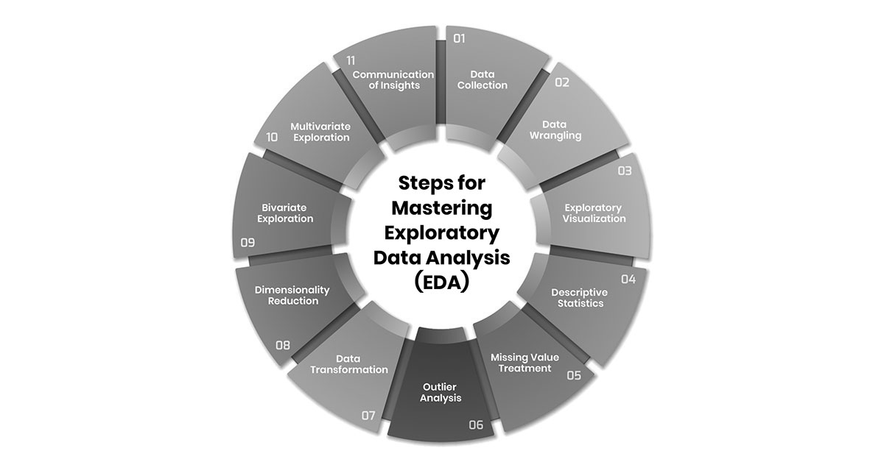
What is EDA in Data Analysis

Slide 21
Definition of EDA
Understanding EDA
EDA refers to exploratory data analysis, which involves summarizing data sets to foster greater understanding of the data's structure, patterns, and insights before formal modeling.

Slide 22
Importance of EDA
Guiding Discovery
EDA guides data scientists in uncovering hidden patterns and insights by visualizing data, which drives hypothesis generation.
Informed Decisions
Understanding data through EDA helps stakeholders make informed decisions backed by evidence from analyzed trends.

Slide 23
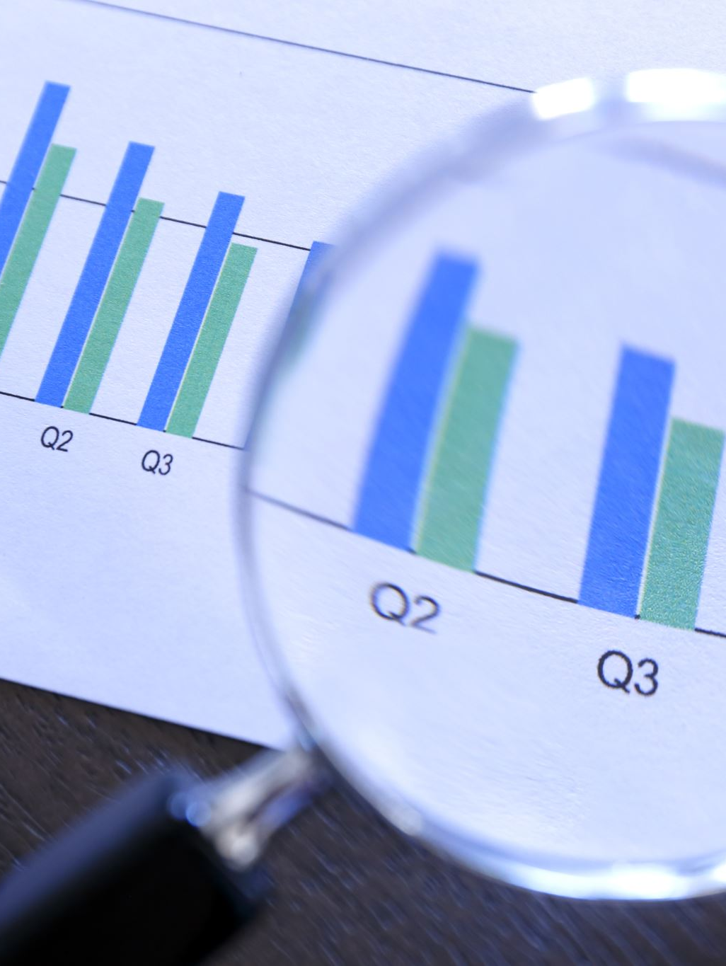
Exploratory Data Analysis (EDA)
Steps in eda
Reading Dataset
Analyzing the Data
Data Reduction
Feature Engineering
Creating Features
Data Cleaning/Wrangling
EDA Exploratory Data Analysis
Statistics Summary
EDA Univariate Analysis
Data Transformation
EDA Bivariate Analysis

Slide 24
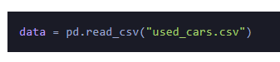
Step 1: Reading Dataset
The Pandas library offers a wide range of possibilities for loading data into the pandas DataFrame from files like JSON, .csv, .xlsx, .sql, .pickle, .html, .txt, images etc.
Most of the data are available in a tabular format of CSV files. It is trendy and easy to access. Using the read_csv() function, data can be converted to a pandas DataFrame.
In this session
the data to predict Used car price is being used as an example. In this dataset, we are trying to analyze the used car’s price and how EDA focuses on identifying the factors influencing the car price. We have stored the data in the DataFrame data.

Slide 25

Analyzing the Data
Before we make any inferences, we listen to our data by examining all variables in the data.
The main goal of data understanding is to gain general insights about the data, which covers the number of rows and columns, values in the data, datatypes, and Missing values in the dataset.
shape – shape will display the number of observations(rows) and features(columns) in the dataset
There are 7253 observations and 14 variables in our dataset
head() will display the top 5 observations of the dataset

Slide 26
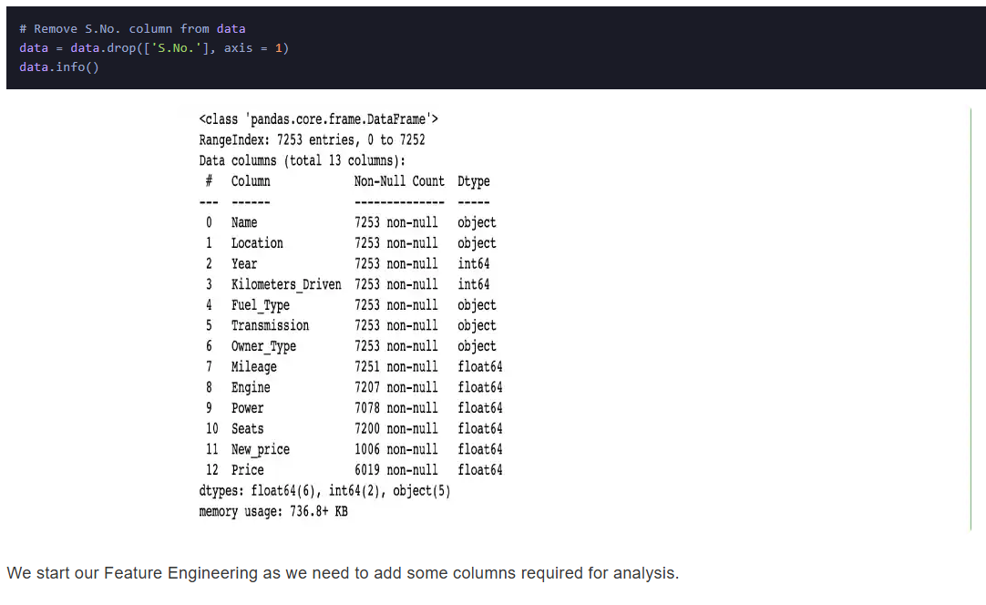
Step 2: Data Reduction
Some columns or variables can be dropped if they do not add value to our analysis.
In our dataset, the column S.No have only ID values, assuming they don’t have any predictive power to predict the dependent variable.

Slide 27
Step 3: Feature Engineering
Feature engineering refers to the process of using domain knowledge to select and transform the most relevant variables from raw data when creating a predictive model using machine learning or statistical modeling. The main goal of Feature engineering is to create meaningful data from raw data.

Slide 28
Step 4: Creating Features
We will play around with the variables Year and Name in our dataset. If we see the sample data, the column “Year” shows the manufacturing year of the car.
It would be difficult to find the car’s age if it is in year format as the Age of the car is a contributing factor to Car Price.
Introducing a new column, “Car_Age” to know the age of the car

Slide 29
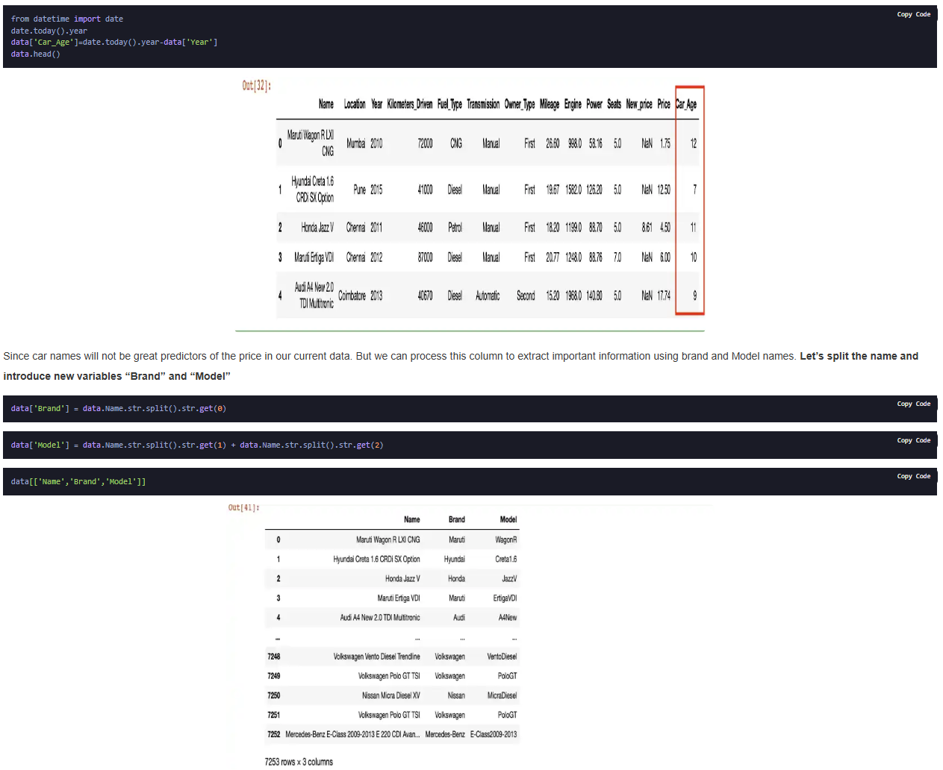
Step 4: Creating Features

Slide 30
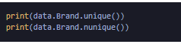
Data Cleaning/Wrangling
Some names of the variables are not relevant and not easy to understand. Some data may have data entry errors, and some variables may need data type conversion. We need to fix this issue in the data.
In the example, The brand name ‘Isuzu’ ‘ISUZU’ and ‘Mini’ and ‘Land’ looks incorrect. This needs to be corrected

Slide 31
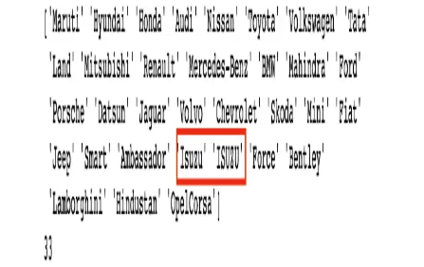
Data Cleaning/Wrangling

Slide 32
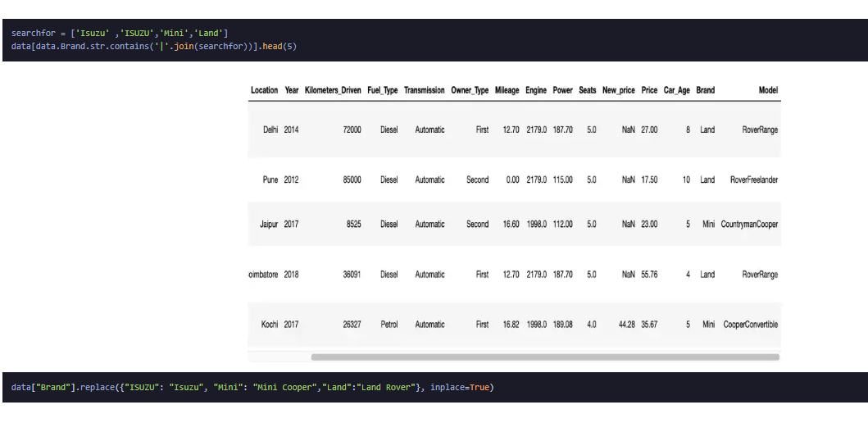
Data Cleaning/Wrangling

Slide 33
EDA Exploratory Data Analysis
Exploratory Data Analysis refers to the crucial process of performing initial investigations on data to discover patterns to check assumptions with the help of summary statistics and graphical representations.
EDA can be leveraged to check for outliers, patterns, and trends in the given data.
EDA helps to find meaningful patterns in data.
EDA provides in-depth insights into the data sets to solve our business problems.
EDA gives a clue to impute missing values in the dataset

Slide 34


EDA in Data Analysis
Exploratory Data Analysis (EDA) is a critical step in data analysis and machine learning that helps to understand data distributions, spot anomalies, and uncover patterns. This presentation will delve into EDA's principles, techniques, and tools.

Slide 35

Introduction to Exploratory Data Analysis (EDA)
Definition and Purpose
Importance in Data Science
Key Concepts
EDA refers to the analysis of data sets to summarize their key characteristics, often with visual methods.
Includes central tendencies, variability, and distribution shapes like normal and skewed.
It ensures that the data used is suitable for analysis, identifying trends and relationships.

Slide 36


Exploring EDA Techniques
1
Descriptive Statistics
2
Data Visualization
Provide summary through mean, median, mode, and range.
Techniques like histograms, box plots, and scatter plots make data interpretation intuitive.
3
Univariate Analysis
4
Multivariate Analysis
Analyzes a single variable to understand its distribution and characteristics.
Investigates relationships among multiple variables to identify correlations.
5
Outlier Detection
Identifies anomalies in data using techniques like IQR or Z-score.

Slide 37






Tools for Exploratory Data Analysis
Data Visualization Libraries
Python Libraries
Matplotlib and Seaborn offer flexible plotting options and enhanced aesthetics.
Essential for data manipulation and exploratory analysis using Pandas and NumPy.
2
1
R Programming
3
Utilizes packages like ggplot2 for comprehensive EDA workflows.
5
4
Tableau and Power BI
User-friendly tools for visualization and EDA without extensive coding.
Jupyter Notebooks
Ideal for interactive EDA combining code, text, and visualizations.

Slide 38



Best Practices in EDA
Effective Exploratory Data Analysis (EDA) is essential for deriving actionable insights and guiding decision-making. By following best practices, teams can optimize their EDA process and enhance data understanding for improved outcomes.
Iterative Approach
Document Findings
Feature Engineering
The EDA process should be iterative, allowing findings to inform subsequent analyses.
Keeping a record of observations is crucial for future reference and insights sharing.
EDA insights inform feature engineering, deriving new variables to enhance model performance.
Consider Domain Knowledge
Balance Between Depth and Speed
Incorporating domain knowledge enhances the EDA process, guiding relevant inquiries.
Striking a balance between thoroughness and efficiency in EDA is essential.

Slide 39






Challenges in EDA
Complexity of Data Types
Data Quality Issues
Large and complex datasets, especially with categorical variables, necessitate specialized analysis techniques.
Poor data quality can severely impede EDA efforts, requiring additional time and resources to clean the data effectively.
2
1
Scaling EDA for Big Data
3
Traditional EDA methods face challenges with the volume and variety of big data, requiring scalable tools.
5
Time Consumption
4
Exploratory data analysis can be time-consuming, balancing thoroughness with project deadlines is a key challenge.
Subjectivity in Interpretation
Interpretation biases can skew conclusions, making collaboration essential for validation.

Slide 40

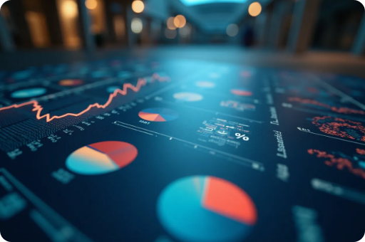

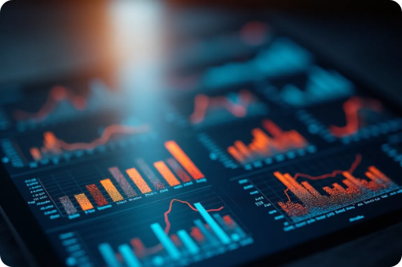


Case Study: EDA in Practice
Dataset Overview
Initial Review
Data Visualization
Retail dataset featuring sales figures, transaction times, product details, and customer demographics.
Importing, cleaning, and generating descriptive statistics to identify trends and patterns.
Using bar plots and scatter plots to uncover correlations and trends in sales.
Key Insights
Model Development Precursor
Revealing customer segments, seasonal buying patterns, and insights for future marketing.
Utilizing EDA knowledge to enhance predictive model building through relevant feature selection.

Slide 41

Conclusion
Exploratory Data Analysis (EDA) plays a crucial role in data science by enhancing the validity of analyses and models. Its integration with advanced technologies promises a more efficient data exploration process.
Summary of EDA Significance
Future Trends
The future of EDA lies in automation and integration with machine learning techniques.
EDA is paramount in data analysis and machine learning, providing essential insights.

Slide 42


Data Visualization Techniques
This presentation explores data visualization using Matplotlib and Seaborn, two powerful Python libraries. It covers their functionalities, key features, and practical applications for creating captivating visual representations of data.

Slide 43

Introduction to Matplotlib
Overview of Matplotlib
Basic Components
Installation and Setup
Matplotlib is a versatile library for creating static, animated, and interactive visualizations in Python.
Matplotlib primarily includes figures, axes, and plots essential for effective visualizations.
Installing Matplotlib is straightforward using pip and can be easily imported into Python scripts.

Slide 44


Visualization with Matplotlib
1
Line and Scatter Plots
2
Bar and Histogram Charts
3
Customization Options
These fundamental types depict trends and relationships between variables, essential for exploratory data analysis.
Bar charts are perfect for categorical data, while histograms visualize frequency distributions, aiding in data comparisons.
Matplotlib's extensive customization includes colors, labels, and legends, enhancing visual clarity and aesthetics.

Slide 45



Introduction to Seaborn
Key Features
Seaborn includes built-in themes and support for complex visualizations such as violin plots and heat maps.
2
Overview of Seaborn
Seaborn is built on top of Matplotlib and provides a high-level interface for drawing attractive statistical graphics.
1
3
Installation and Usage
Seaborn can be installed using pip and integrates easily into existing Matplotlib visualizations.

Slide 46


Visualization with Seaborn
Statistical Plots
Heatmaps and Categorical Plots
Beautiful Defaults
Seaborn's functions handle statistical computations, creating various plots for insights.
Seaborn provides aesthetically pleasing charts with minimal effort required.
Utilize heatmaps for correlation and categorical plots for data comparisons.

Slide 47



Combining Matplotlib and Seaborn
Advanced Customization
2
Combine Matplotlib’s features with Seaborn’s convenience for complex visualizations.
Creating Composite Visualizations
1
Use Seaborn to enhance Matplotlib plots with better aesthetics.
Real-world Applications
3
Apply combined techniques in sectors like finance, healthcare, and marketing.

Slide 48



Practical Applications of Data Visualization
Business Intelligence
Scientific Research
Education and Training
Data visualization plays a crucial role in business intelligence, where stakeholders need to quickly grasp insights from complex data sets to inform strategies and decisions.
Visualizations are pivotal in scientific research for clearly conveying results and trends, facilitating communication among researchers and the broader audience.
Effective data visualization aids in teaching complex concepts, making learning more engaging and accessible for students in various disciplines.

Slide 49



Conclusion on Data Visualization Tools
Enhanced Analytical Skills
2
Data Visualization Importance
Mastering these tools significantly boosts analytical capabilities.
1
Utilizing Matplotlib and Seaborn empowers effective data exploration and presentation.
Clearer Insight Communication
3
Facilitates clearer communication of insights across various fields.

Slide 50

Statistical Tools for Data Analysis
This presentation explores statistical tools that are essential for summarizing and analyzing data. Understanding these tools aids in making informed decisions based on data insights.

Slide 51
Descriptive Statistics Overview
Mean, Median, Mode
Range and Variance
Standard Deviation
These measures summarize data by indicating the average, middle, and most frequent values.
Range indicates the spread of the data, while variance quantifies the degree of variation.
This statistic expresses how much data deviates from the mean, offering insights into data consistency.

Slide 52
Data Visualization Techniques
1
Bar and Pie Charts
2
Histograms
3
Box Plots
Ideal for representing categorical data visually.
Graphical representation of frequency distribution of numerical data.
Showcases distribution based on summary statistics, highlighting median and outliers.

Slide 53



Inferential Statistics Techniques
Confidence Intervals
2
Provide a range of values to estimate population parameters.
Hypothesis Testing
1
Uses sample data to make conclusions about a population.
3
Regression Analysis
Analyzes relationships between variables for predictions.

Slide 54

Correlation Analysis
Pearson Correlation Coefficient
Spearman's Rank Correlation
Scatter Plots
Visualizes relationships and identifies correlation trends.
Assesses linear relationship strength and direction.
Measures association between ranked variables.

Slide 55



Data Cleaning Techniques
Outlier Detection
Identifying and managing outliers is crucial, as they can skew results and mislead interpretations; techniques include using z-scores or IQR methods.
2
Handling Missing Data
Addressing missing values through methods like deletion or imputation ensures data integrity, allowing for more accurate analysis and conclusions.
1
Data Transformation
3
Normalizing or standardizing data prepares it for analysis, enhancing models' performance and ensuring that results are valid and interpretable.

Slide 56



Software Tools Overview
Excel
R and Python
Statistical Software
A versatile tool used for basic statistical analysis and visualization.
Powerful programming languages for statistical analysis and advanced modeling.
Tools like SPSS and SAS facilitate complex analysis through user-friendly interfaces.

Slide 57



Conclusion and Recommendations
Mastering statistical tools is key to extracting meaningful insights and supporting data-driven decisions. Continuous education in the latest techniques is vital, as statistical tools find broad applications across business, healthcare, and many other fields.
Continuous Learning
2
Ongoing education in statistical tools is crucial for professionals.
Importance of Statistical Tools
1
Mastering statistical tools is essential for effective data analysis.
Application in Various Fields
3
Statistical tools are widely applicable in multiple domains.

Slide 58
Data Visualization with Matplotlib & Seaborn
Data visualization is essential for interpreting complex datasets. Matplotlib and Seaborn are powerful Python libraries that make it easier to create informative and visually appealing graphics to enhance data analysis.

Slide 59
Introduction to Matplotlib
What is Matplotlib?
Basic Plotting
Matplotlib is a widely-used Python library for creating static, animated, and interactive visualizations.
Users can create basic plots like line charts, bar graphs, and scatter plots.
Customization Options
Integration with Other Libraries
Matplotlib offers extensive customization options for fonts, colors, and styles.
It integrates seamlessly with NumPy and Pandas for easy data visualization.

Slide 60
Introduction to Seaborn
1
What is Seaborn?
2
Data Exploration
Seaborn enhances Matplotlib with attractive statistical graphics.
Easily explore variable relationships through various visualizations.
3
Built-in Themes
4
Support for Pandas
Offers themes and palettes for visually appealing graphics.
Ideal for creating visualizations with Pandas DataFrames.

Slide 61





Comparison of Matplotlib and Seaborn
Ease of Use
Plot Types
Seaborn simplifies the syntax for creating complex visualizations compared to Matplotlib, making it more accessible for beginners. This can lead to quicker iteration during data analysis.
While Matplotlib offers a wide range of plot types, Seaborn specializes in statistical plots, such as regression plots and categorical plots, making it ideal for statistical data.
1
2
Interactivity
Aesthetics
4
3
Although both libraries can generate interactive plots, Matplotlib has more options to create interactive visualizations while Seaborn focuses on creating aesthetically pleasing static plots.
Seaborn provides better default aesthetics and style options, which reduces the need for extensive customization in Matplotlib. This enhances the visual quality of outputs without much effort.

Slide 62
Practical Examples with Matplotlib
Creating Line Graphs
Bar Charts and Histograms
Easily plot time series data with axis labeling and titles for clarity.
Visualize categorical and frequency distributions to understand data behavior.
Scatter Plots
Subplots and Multi-Graphs
Visualize relationships between two numerical variables to identify correlations.
Create subplots for comparing multiple datasets in a single figure.

Slide 63




Practical Examples with Seaborn
Heatmaps
Pair Plots
1
2
Display distributions and relationships between variable pairs in a grid format.
Visualize correlation matrices for quick relationships identification.
Facet Grids
Box and Violin Plots
4
3
Visualize data across multiple subplots based on categorical variables.
Illustrate dataset distributions, highlighting median, quartiles, and outliers.

Slide 64

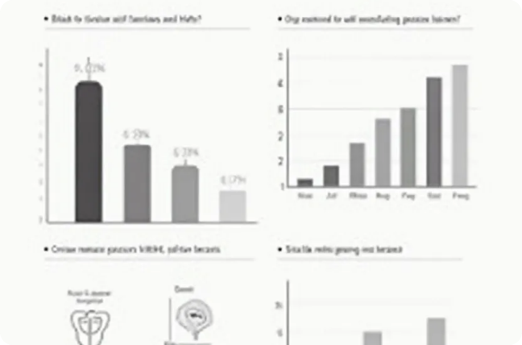
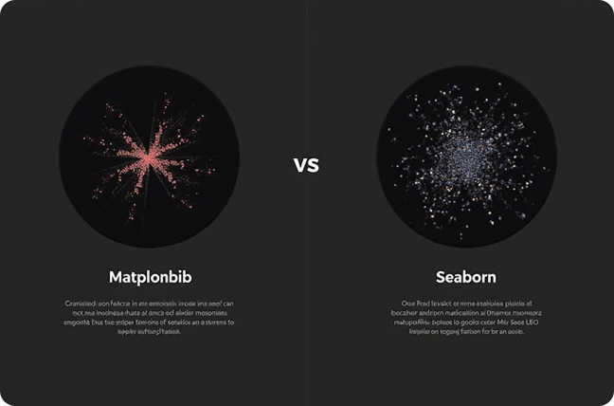


Conclusion of Data Visualization Insights
Importance of Data Visualization
Choosing the Right Tool
Crucial for extracting insights and effectively communicating findings.
Understanding strengths of Matplotlib and Seaborn for better library selection.
Continuous Learning
Resources for Further Learning
Experimenting and learning enhances proficiency for better visualizations.
Online tutorials, documentation, and community forums to expand knowledge.

Slide 65

Creating Plots with Matplotlib
This presentation explores how to create static, animated, and interactive plots using Matplotlib, a powerful plotting library in Python, highlighting its features and practical applications.

Slide 66
Introduction to Matplotlib
Overview of Matplotlib
Installation and Setup
Basic Plot Types
Matplotlib is a widely used Python library for creating static, animated, and interactive visualizations in a variety of formats.
Installing Matplotlib is straightforward via pip, and it integrates seamlessly with Jupyter Notebooks for interactive use.
Matplotlib supports a range of basic plot types including line plots, bar charts, and scatter plots, allowing for diverse data visualization.

Slide 67
Creating Static Plots
1
Line Plots
2
Customizing Plots
3
Saving Figures
Line plots are created using the plot() function, great for visualizing trends over time.
Customization options like titles, labels, and legends enhance clarity.
Plots can be saved in formats like PNG, PDF, and SVG using savefig().

Slide 68
Animated Plots
Creating Simple Animations
2
Users can update plot elements in a loop using the FuncAnimation class.
Introduction to Animation
1
Matplotlib's animation module allows for the creation of dynamic plots.
Customization in Animations
3
Animations can be customized with features like frame intervals and looping.

Slide 69

Creating Interactive Plots with Matplotlib
Using Widgets
Event Handling
Integration with Other Libraries
Matplotlib can integrate with Jupyter Widgets, allowing users to create interactive plots that respond to user inputs.
Event handling capabilities enable custom responses to mouse and keyboard events for interactivity.
Combining Matplotlib with libraries like Plotly or Bokeh can enhance interactivity and user engagement.

Slide 70
Case Study: Data Visualization
Combining Plot Types
2
Demonstrate how to combine different plot types within a single figure to convey complex information effectively.
Dataset Selection
Choose a relevant dataset that showcases trends or patterns to visualize, maximizing the impact of the plot.
1
Interpreting Results
Discuss how to interpret the visualizations generated, emphasizing insights drawn from the data and how they can inform decision-making.
3

Slide 71



Best Practices
Simplicity and Clarity
Color Usage
Annotations and Labels
Maintain simplicity in design while ensuring that plots are clear and comprehensible, avoiding clutter that can confuse viewers.
Using color wisely can significantly enhance the effectiveness of a plot, with appropriate color schemes aiding in distinguishing data elements.
Proper use of annotations and labels can provide additional context for the data presented, guiding the audience's understanding.

Slide 72
Conclusion and Future Work
Further Exploration
2
Encourage viewers to delve deeper into Matplotlib's documentation.
Recap of Key Points
1
Summarize the steps in creating static, animated, and interactive plots.
Future Learning Opportunities
3
Highlight the value of mastering Matplotlib and other tools.

Slide 73
Customizing Graphs for Storytelling
Effective storytelling through graphs enhances data understanding by providing clarity, engaging visuals, and relatability. By customizing graphs, we can effectively communicate key messages and insights to our audience.

Slide 74
Importance of Customization
Enhances Clarity
Engages the Audience
Communicates Key Messages
Customizing graphs allows for clearer presentation of complex data, helping the audience to quickly grasp essential information.
Tailored visuals capture attention and maintain interest, making the data more appealing and easier to interpret.
Customization enables focused storytelling by highlighting the most relevant data points, ensuring that the key messages are effectively conveyed.

Slide 75
Choosing the Right Graph
1
Understand Your Data
2
Consider the Audience
3
Use Clear Titles and Labels
Different data types call for specific graph types; understanding the nature of your data is key to selecting the right visualization.
Tailor the graph type to your audience’s familiarity and preferences, ensuring the chosen graph is accessible and engaging for them.
Every graph should have a descriptive title and clear labels to provide context, allowing the audience to immediately understand the information being presented.

Slide 76
Color and Design Elements
Incorporating color and design elements strategically can significantly enhance the effectiveness of presentations. A consistent color palette, contrasting colors for emphasis, and clear visual hierarchy are crucial for guiding the audience's focus and improving comprehension.
Contrasting Colors
2
Use contrasting colors to emphasize important data points.
Consistent Color Palette
1
A coherent color scheme can enhance aesthetics and improve comprehension.
Visual Hierarchy
3
Organize elements by importance; larger visuals represent significant data.

Slide 77
Adding Annotations and Highlights
Use Annotations Wisely
Highlight Key Trends
Provide Contextual Information
Short notes or arrows clarify complex graph parts.
Use highlights for crucial data trends or outliers.
Brief explanations enhance interpretation of the data.

Slide 78
Storytelling Techniques
Connect Data Points to Real-Life Scenarios
2
Relating data to familiar contexts helps audiences relate to the material and understand its implications better.
Establish a Narrative Arc
Every data story should follow a beginning, middle, and end; use your graphs to outline this structure.
1
Incorporate Emotional Appeal
3
Use visuals that evoke emotions or prompt reactions, ensuring that the audience is not just informed but also engaged.

Slide 79



Tools for Graph Customization
Data Visualization Software
Graphic Design Software
Online Graph Generators
Use Adobe Illustrator or Canva for more creative graphical edits, allowing for greater control over aesthetics.
Platforms like Piktochart or Infogram can quickly produce customizable graphs with minimal design experience required.
Tools like Tableau, Microsoft Power BI, or Google Data Studio offer robust features for creating and customizing graphs.

Slide 80
Conclusion and Best Practices
Stay Updated with Design Trends
2
Iterate and Gather Feedback
Regularly check for new trends in data visualization to keep your graphs fresh and engaging.
1
Always seek feedback after presenting your graphs to understand their effectiveness and areas for improvement.
Keep Learning
Continuously enhance your skills in data storytelling and graph customization; it’s a journey that can lead to powerful communication of insights.
3

Slide 81
Using Seaborn for Advanced Stats
Seaborn is a powerful Python visualization library based on Matplotlib that provides an interface for drawing attractive statistical graphics. It simplifies the process of creating complex visualizations and exploring data relationships.

Slide 82
Introduction to Seaborn
What is Seaborn?
Key Features
Installation
Seaborn is a Python data visualization library that provides a high-level interface for drawing attractive statistical graphics with ease, built on top of Matplotlib.
It includes support for complex visual representations, such as heatmaps and categorical plots, and allows for easy integration with Pandas DataFrames.
Seaborn can be installed using pip or conda, and it requires Matplotlib and NumPy as dependencies for working effectively.

Slide 83
Basic Plotting Functions
1
Scatterplots
2
Line Plots
3
Bar Plots
Seaborn's scatterplot() function helps visualize relationships between two continuous variables and can encode additional information through colors and sizes.
The lineplot() function is useful for displaying trends over time, connecting data points and offering insights into temporal patterns effortlessly.
Bar plot visualizations can be created using barplot(), summarizing categorical data and showing means or totals, providing quick insights on comparisons.

Slide 84
Advanced Visualizations
Pair Plots
The pairplot() function allows for visualizing relationships between multiple variables in a DataFrame, creating a matrix of scatterplots for deeper insights.
Heatmaps
2
Seaborn excels in creating heatmaps using the heatmap() function, which visually represents matrix-like data distributions, often useful in correlation matrices.
1
Facet Grids
3
The FacetGrid() function is invaluable for creating complex multi-plot layouts, enabling visualization of data facets across different conditions in a single frame.

Slide 85
Customizing Visual Aesthetics
Themes and Styles
Color Palettes
Annotations and Titles
Seaborn provides built-in themes to enhance plot aesthetics through set_theme() and set_style().
Customization of color palettes enhances visual appeal and clarity with various options.
Annotations and titles improve understanding through functions like set_title() and annotate().

Slide 86
Statistical Functions
Distribution Plots
Seaborn's distplot() (now replaced by displot()) helps visualize the distribution of a single variable, showcasing histograms and density curves with ease.
2
Regression Plots
The regplot() function combines scatter and regression line visualizations, enabling users to observe trends and fit models to their data effectively.
1
Box and Violin Plots
The boxplot() and violinplot() functions provide insights into data distributions, highlighting medians, quartiles, and outliers effectively through graphical representation.
3

Slide 87



Integrating with Pandas
DataFrame Support
GroupBy Operations
Time Series Visualization
Seaborn works seamlessly with Pandas DataFrames, simplifying data management and visualization processes.
Users can leverage Pandas' groupby features to aggregate data and visualize it directly with Seaborn.
By integrating Pandas timestamps with Seaborn's plotting functions, users can create compelling time series visualizations.

Slide 88
Conclusion and Best Practices in Data Visualization
Combining with Other Libraries
2
Data Visualization Importance
Leverage Seaborn with other libraries for interactivity.
1
Good visualization practices are crucial for interpreting complex data.
Continuous Learning
3
Stay updated with new Seaborn functionalities.

Slide 89
Predictive Analytics Basics
Predictive analytics involves using data analysis techniques alongside machine learning to forecast future events and behaviors. This presentation will explore the fundamental concepts, processes, and tools in predictive analytics using Python.

Slide 90
Introduction to Predictive Analytics
Definition and Purpose
Applications
Benefits
Predictive analytics uses statistical algorithms and machine learning techniques to identify the likelihood of future outcomes based on historical data.
Common applications include fraud detection, customer segmentation, risk management, and demand forecasting across various industries.
Employing predictive analytics helps businesses enhance decision-making, optimize operations, and improve customer engagements by anticipating trends.

Slide 91
Data Collection and Preparation
1
Data Sources
2
Data Cleaning
3
Feature Engineering
Gathering data from various sources is crucial; these may include databases, APIs, and web scraping, each providing valuable insights.
Cleaning data ensures accuracy by removing duplicates, correcting errors, and handling missing values, which is essential for reliable analysis.
Creating new features from raw data can enhance model performance. This involves transforming existing variables or creating new ones to provide better predictive power.

Slide 92
Machine Learning Fundamentals
Unsupervised Learning
This approach uses unlabeled data to discover patterns or groupings, with techniques like clustering and principal component analysis (PCA).
Supervised Learning
2
Involves training models on labeled data, where the outcome is known, using algorithms such as linear regression, decision trees, and support vector machines.
1
Evaluation Metrics
3
Assessing model performance is vital. Common metrics include accuracy, precision, recall, and F1-score, helping to refine predictive models.

Slide 93

Implementing Predictive Models in Python
Libraries and Tools
Model Training
Prediction and Interpretation
Python libraries such as Scikit-learn, Pandas, and Matplotlib are widely used for data manipulation, model building, and visualization.
This involves selecting algorithms, fitting the model to the training dataset, and tuning hyperparameters for optimal performance.
After training, models can predict future outcomes, and interpreting results helps understand which factors most influence predictions.

Slide 94
Challenges in Predictive Analytics
Overfitting
2
This occurs when a model learns noise in the training data rather than the underlying patterns, resulting in poor performance on new data.
Data Quality Issues
Poor data quality can lead to inaccurate predictions. It's essential to address issues related to data integrity and consistency.
1
Ethical Considerations
3
Using predictive analytics raises ethical issues, including biases in data and decisions. Ensuring fair and responsible use is crucial.

Slide 95



Future Trends in Predictive Analytics
AI Integration
Real-time Analytics
Personalization
The integration of artificial intelligence will enable more sophisticated predictive capabilities, providing deeper insights and automation.
Businesses are increasingly leveraging real-time data for immediate decision-making, enhancing agility and responsiveness.
As predictive analytics evolves, the ability to personalize customer experiences will improve, driving engagement and loyalty.

Slide 96
Harnessing Predictive Analytics
Utilizing Methods
2
Apply various methods to extract insights from data.
Understanding Basics
1
Learn foundational concepts of predictive analytics.
Overcoming Challenges
3
Identify and address common obstacles in implementation.

Slide 97
Introduction to Machine Learning Algorithms
Machine learning algorithms are vital tools in data analysis and artificial intelligence. They enable systems to learn from data, identify patterns, and make decisions with minimal human intervention.

Slide 98
Types of Machine Learning
Supervised Learning
Unsupervised Learning
Reinforcement Learning
Models are trained on labeled data to map inputs to correct outputs.
Analyzes unlabeled data to identify patterns and groupings.
Agents make decisions to maximize cumulative reward in an environment.

Slide 99
Popular Algorithms Overview
1
Linear Regression
2
Decision Trees
A fundamental algorithm for predicting continuous outcomes. It assumes a linear relationship between input variables and a single output, making it easy to interpret.
These models use a tree-like structure to make decisions, allowing for both regression and classification tasks. They split data into branches based on feature values.
3
Support Vector Machines
4
Neural Networks
SVMs are powerful for classification tasks. They find the hyperplane that best separates data points of different classes in high-dimensional space.
Inspired by the human brain, these algorithms consist of interconnected layers of nodes (neurons) and are effective for complex data patterns.

Slide 100
Evaluation Metrics
Accuracy
Precision and Recall
The ratio of correctly predicted instances to the total instances, potentially misleading for imbalanced data.
Precision reflects the accuracy of positive predictions, while recall assesses the model's ability to identify all relevant instances.
1
2
Confusion Matrix
F1 Score
4
3
A table that visualizes classification model performance, detailing true positives, false positives, true negatives, and false negatives.
The harmonic mean of precision and recall, providing a balanced measure for classification models, essential for imbalanced datasets.

Slide 101

Applications of Machine Learning
Healthcare
Finance
Machine learning is employed for predictive analytics in patient diagnosis and treatment recommendations, improving clinical decision-making processes.
Algorithms are critical in fraud detection systems, risk assessment, algorithmic trading, and personalized financial recommendations for customers.
Marketing
Autonomous Vehicles
Businesses use machine learning for customer segmentation, predicting consumer behavior, and optimizing marketing campaigns through targeted strategies.
Machine learning plays a key role in enabling vehicles to perceive their environment and make real-time decisions, enhancing safety and efficiency in transportation.

Slide 102
Challenges in Machine Learning
Data Quality
Overfitting
Poor quality data can lead to misleading insights and poor algorithm performance. Ensuring accurate, complete, and relevant data is essential for successful machine learning applications.
This occurs when models perform well on training data but poorly on unseen data due to being too complex. Techniques like cross-validation are crucial to mitigate this risk.
1
2
Ethical Concerns
Interpretability
Issues like algorithmic bias, privacy concerns, and the potential for automation to displace jobs are emerging concerns that require careful consideration.
4
3
Many machine learning models can be black boxes, making it difficult to interpret their decisions. This is particularly problematic in regulated industries like healthcare.

Slide 103

Future Trends in Machine Learning
Explainable AI
Automated Machine Learning
A push towards interpretable models for transparency in AI systems.
Automating the entire machine learning process for non-experts.
Federated Learning
Integration with IoT
Training models across decentralized data sources for enhanced privacy.
ML systems combined with IoT for data-driven insights across industries.

Slide 104
Overview of Key Machine Learning Techniques
This presentation provides an overview of essential machine learning techniques, discussing their applications, advantages, and key concepts, aimed at understanding the vast field of machine learning.

Slide 105
Understanding Supervised Learning
Definition and Purpose
Common Algorithms
Applications
Trains models on labeled data to predict outcomes.
Includes linear regression, logistic regression, SVM, and decision trees.
Used in spam detection, sentiment analysis, and credit scoring.

Slide 106
Understanding Unsupervised Learning
1
Understanding Unsupervised Learning
2
Clustering Techniques
3
Dimensionality Reduction
Algorithms like K-means and DBSCAN help group similar data points, identifying intrinsic relationships.
This technique deals with unlabeled data, identifying patterns without specific output guidance.
Techniques such as PCA and t-SNE simplify data analysis while retaining essential information.

Slide 107
Reinforcement Learning
Reinforcement learning involves agents that use trial and error to make decisions by receiving feedback in the form of rewards or penalties, optimizing their strategies over time.
Key Components
Essential elements include the agent, environment, actions, rewards, and policy, with the agent adapting its strategy to maximize rewards.
Concept Overview
2
Reinforcement learning is based on agents who learn to make decisions through trial and error, receiving rewards or penalties in an environment.
1
Applications
3
Applied in robotics, game playing like AlphaGo, and personalized recommendations, demonstrating versatility and effectiveness.

Slide 108

Understanding Neural Networks
Introduction to Neural Networks
Types of Neural Networks
Deep Learning
Deep learning utilizes multiple layers to extract high-level abstractions, driving advances in NLP and computer vision.
Neural networks are computing systems inspired by the human brain's interconnected neuron structure.
Various architectures exist like feedforward networks, CNNs for image recognition, and RNNs for sequential data analysis.

Slide 109
Decision Trees
Advantages
They are easy to interpret, require minimal data preprocessing, and can handle both numerical and categorical data. Their transparency is useful in decision-making processes.
2
Understanding Decision Trees
Decision trees are flowchart-like structures that make decisions based on answering a series of questions derived from input features, leading to a final output decision.
1
Limitations
3
Decision trees can be prone to overfitting, especially with complex datasets. Techniques such as pruning or ensemble methods like random forests help mitigate this issue.

Slide 110



Ensemble Learning Overview
Overview of Ensemble Learning
Common Methods
Applications
Includes bagging and boosting techniques to enhance accuracy.
Used in finance, healthcare, and marketing for predictive modeling.
Combines multiple algorithms to improve model performance.

Slide 111

Model Evaluation and Validation
Validation Methods
Cross-validation techniques such as k-fold help ensure that models generalize well to unseen data, reducing the risk of overfitting and enhancing predictive reliability.
2
Evaluation Techniques
Assessing models involves metrics like accuracy, precision, recall, and F1-score, providing insights into a model’s performance and its suitability for a given task.
1
Importance of Data Splitting
3
Properly splitting data into training, validation, and test sets is crucial to provide unbiased estimates of model performance, guiding further tuning and improvement efforts.

Slide 112



Future Trends in Machine Learning
Emergence of AutoML
Ethics and Fairness
Integration with Other Technologies
Automated Machine Learning (AutoML) tools are gaining prominence, allowing non-experts to build effective machine learning models by automating key processes.
Addressing ethical concerns and biases in algorithms is vital to ensure fair and responsible use of AI technologies in society.
The convergence of machine learning with IoT, blockchain, and edge computing leads to innovative applications across industries.

Slide 113
Concept of Training and Testing Models
This presentation outlines the core principles of training and testing models in machine learning. It explains their significance, methods, and best practices to ensure optimal model performance.

Slide 114
Introduction to Models
Definition of Models
Importance of Models
Types of Models
A mathematical representation that learns patterns from data.
Essential for classification, regression, and clustering tasks.
Includes linear regression, decision trees, SVM, and neural networks.

Slide 115
Training Phase
1
Training Data
2
Overfitting vs. Underfitting
3
Model Evaluation
A model learns from input-output pairs, adjusting parameters to minimize errors.
Techniques like cross-validation and metrics like accuracy assess a model's generalization.
Overfitting captures noise; underfitting fails to capture patterns.

Slide 116
Testing Phase
Significance of Testing
2
Testing ensures that models don’t just memorize the training data.
Testing Data
After training, the model is evaluated against a separate testing dataset that it hasn't seen.
1
Performance Metrics
3
Different metrics like precision, recall, and AUC help determine a model's strengths.

Slide 117

Best Practices for Model Training
Data Preprocessing
Hyperparameter Tuning
Continuous Learning
Cleaning and preprocessing data is vital because the quality of data directly impacts model performance. Techniques include normalization, handling missing values, and feature engineering.
Adjusting hyperparameters, like learning rate and batch size, can significantly enhance model performance. Techniques like grid search and random search are commonly used for this purpose.
Models should be regularly updated with new data to maintain accuracy. Implementing mechanisms for continuous learning can help adapt models to changing environments.

Slide 118
Challenges in Model Training and Testing
Computational Resources
2
Access to GPUs or cloud computing can alleviate these resource constraints.
Data Imbalance
Techniques such as resampling or using weighted loss functions can help mitigate this issue.
1
Interpretability
3
Using explainable AI techniques can help stakeholders understand model predictions.

Slide 119



Future Trends in Model Development
Automated Machine Learning
Federated Learning
Explainable AI
Training on decentralized data sources while preserving privacy.
The growing need for transparency and insights in complex models.
Automating model selection and hyperparameter tuning increases accessibility.

Slide 120
Importance of Training and Testing Models
Understanding the concepts of training and testing models is crucial for creating effective machine learning solutions. By following best practices and staying informed about new trends, practitioners can better navigate the challenges of model development and deployment.
Best Practices
2
Following guidelines leads to better model outcomes.
Model Understanding
1
Essential for effective machine learning solutions.
Staying Informed
3
Awareness of trends helps in the deployment process.

Slide 121




Q&A
Ask the team anything
Usama Wahab Khan
Twitter : @usamawahabkhan
LinkedIn : Usamawahabkhan
Notes:
https://www.microsoft.com/en-us/ai/responsible-ai

Slide 122
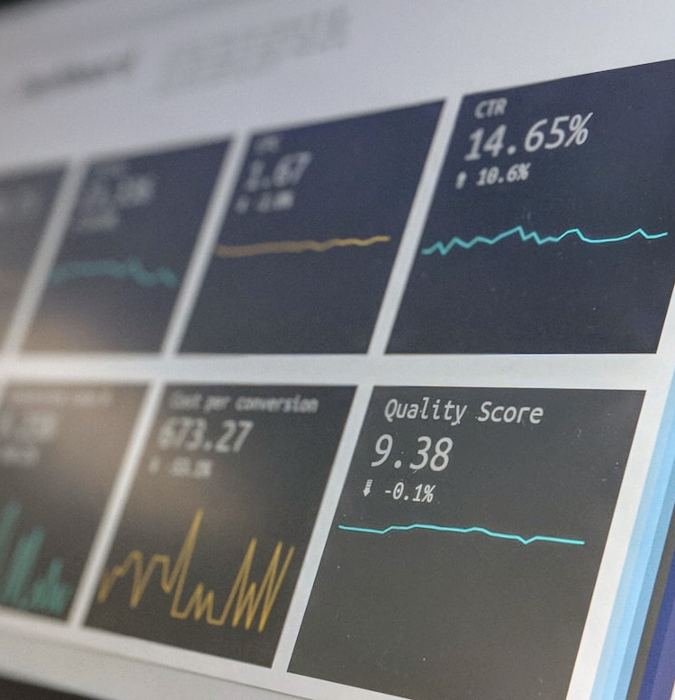
WHAT IS DATA SCIENCE?
Data Science is an interdisciplinary field that combines statistics, computer science, and domain expertise to extract meaningful insights from structured and unstructured data.

